Slide 1
Made Ya Look Mondays | American Artists

Slide 2
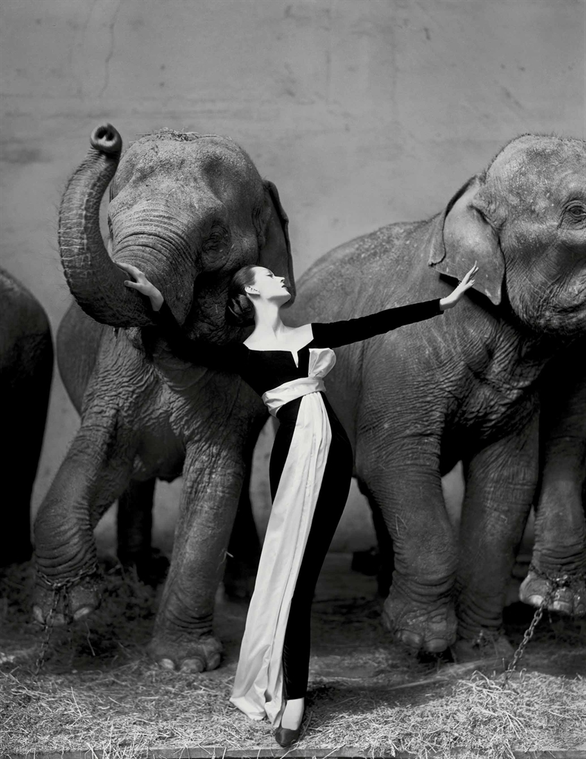
Richard Avedon | Art
Dovima with Elephants, Cirque d'Hiver, Paris
Date: 1955
Medium: Gelatin Silver Print
(from a black & white negative!)
Dimensions:
51.5’’ x 40.75’’
**that’s a big print!**
“...Originally appeared in a 14-page story on Paris fashions published in the September 1955 issue of Harper’s Bazaar… He later recounted, “I saw the elephants under an enormous skylight. . . . I then had to find the right dress and I knew there was a potential here for a kind of dream image.” The dress chosen was in fact the first design for Dior by 19-year-old Yves Saint Laurent. In the photograph Dovima appears poised and fearless..”

Slide 3
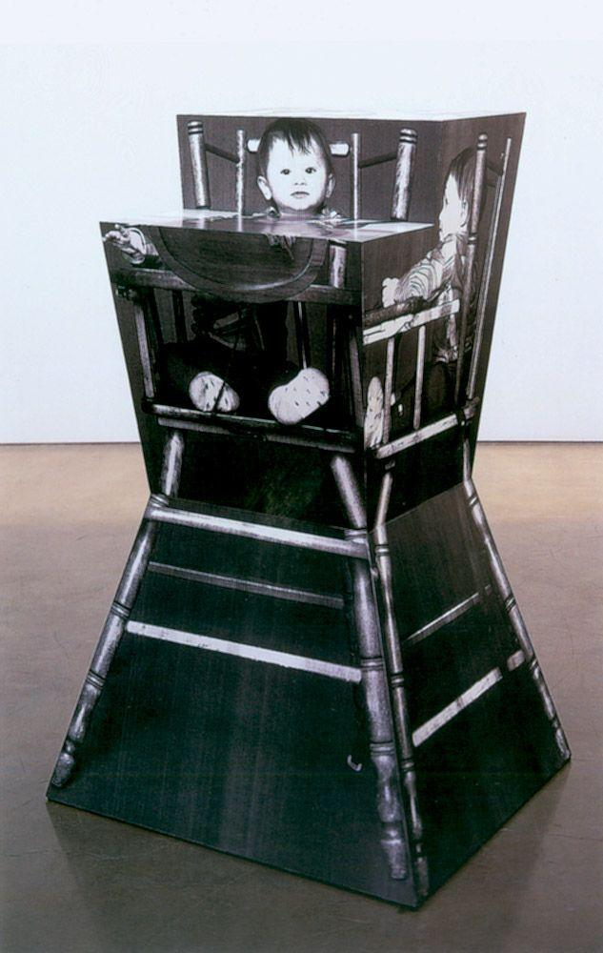
Richard Artschwager | Crafts
Cerise
Date: 2002
Medium: Photographs mounted
on wood
Dimensions:
55’’ x 34’’
Combining elements of cubism, pop art, and minimalism into sculptures that incorporate furniture and create conversation.

Slide 4
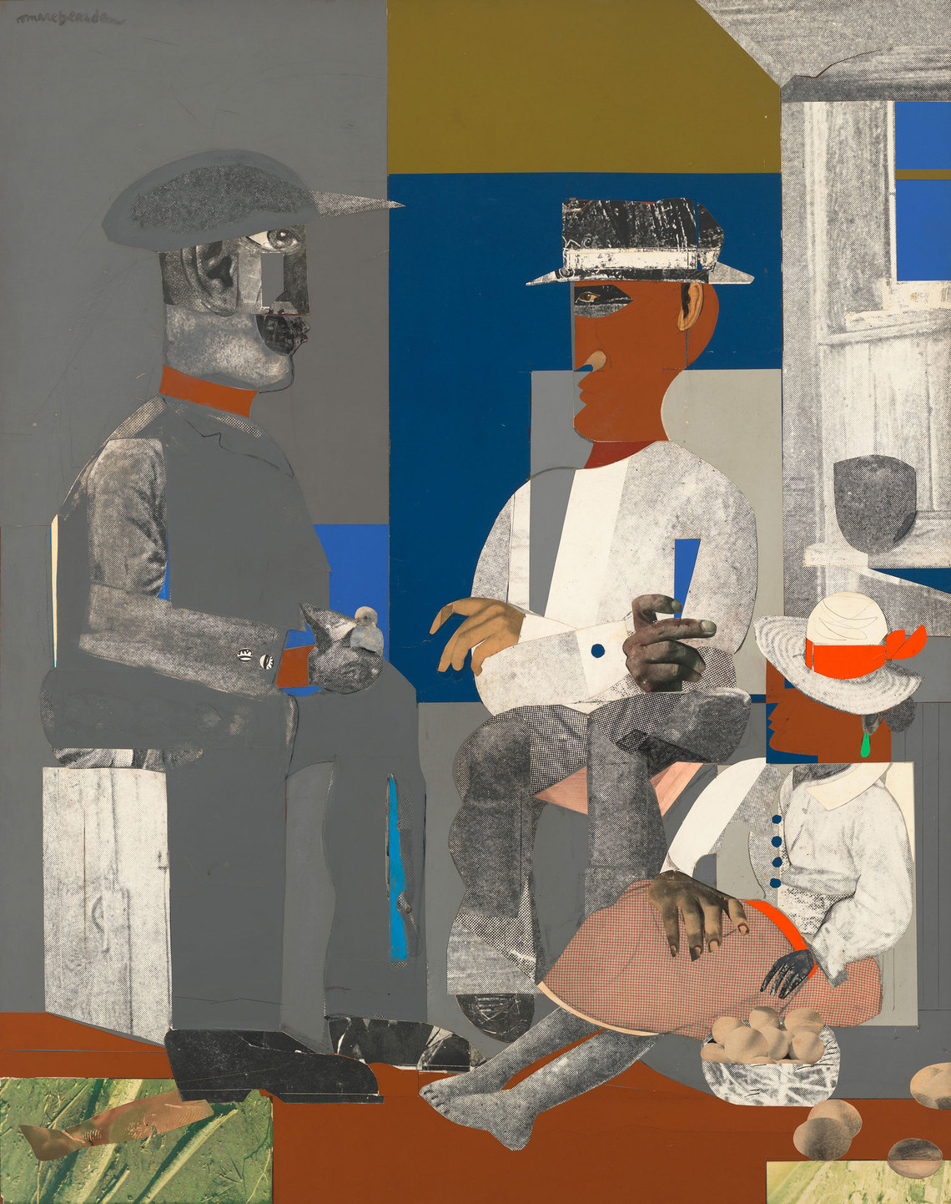
Romare Bearden | Art
Eastern Barn
Date: 1968
Medium: Collage
Dimensions:
55’’ x 43’’
Eastern Barn, composed of photographs, magazine cutouts, and pieces of painted and mottled paper, is likely based on a memory from Romare Bearden’s childhood in the South. Two men, perhaps on a break from work, converse in a barn as a female figure listens in. Bearden’s composition calls attention to its own disjunctive structure. While some details (such as the bird that the man on the left holds in hand or the basket of eggs by the woman’s side) create a three-dimensional effect, the figures are resolutely flat; the grey clothes of the man on the left seem to almost merge into the background. There are shifts in scale too—heads, feet, and hands are disproportionate to bodies, and the bodies in turn seem large compared to the interior space in which they are located.

Slide 5
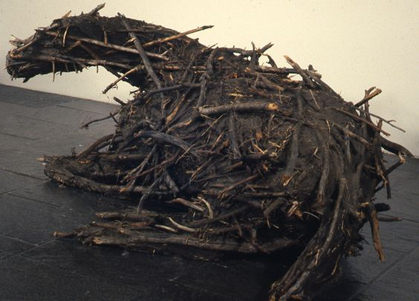
Deborah Butterfield | Crafts
Resting Horse
Date: 1977
Medium: Steel, wire, twigs, clay , paper pulp, dextrine, plaster, and fiberglass
Dimensions: roughly
3 ft wide
6 ft tall
11 ft long

Slide 6
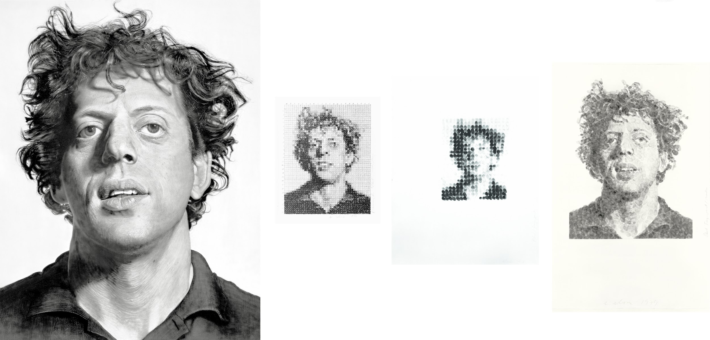
Chuck Close | Art
Phil
Date: 1968-1970
Medium:
-Acrylic & Graphite
-Ink Stamped
-Fingerprints
Dimensions:
108’’ x 84’’
Phil is a portrait of Close's long-time friend, composer Philip Glass. Despite his intimate relationship with the subject of the painting, Close created this work in a calculated, systematic manner. The artist took an 8 x 10-inch photograph of the sitter, overlaid it with a penciled grid, and then painted a vastly enlarged blowup of each square onto the canvas using airbrushes to create a photographic finish. As a result of this drastic enlargement, we see Glass at an uncomfortably close distance from which every mole, hair, and wrinkle is visible. With its cool, almost clinical detachment from its subject, the work functions more like a giant mug shot than a portrait.

Slide 7
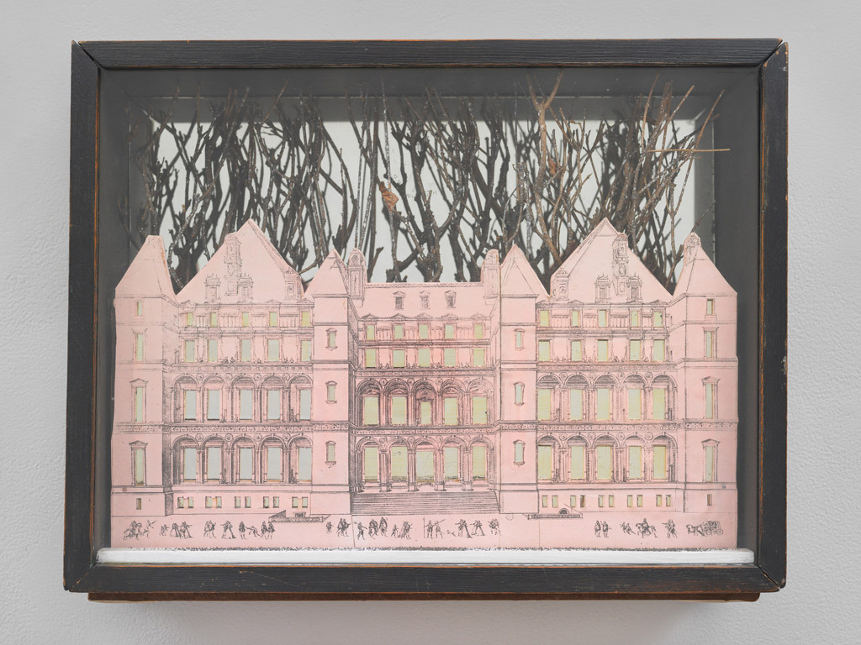
Joseph Cornell | Crafts
Rose Castle
Date: 1945
Medium:
Assemblage
Dimensions: roughly
11.5’’ x 15’’
4’’ deep
He was fascinated not by refuse, garbage, and the discarded, but by fragments of once beautiful and precious objects he found on his frequent trips to the bookshops and thrift stores of New York. His boxes relied on the Surrealist use of irrational juxtaposition, and nostalgia, for their appeal.

Slide 8
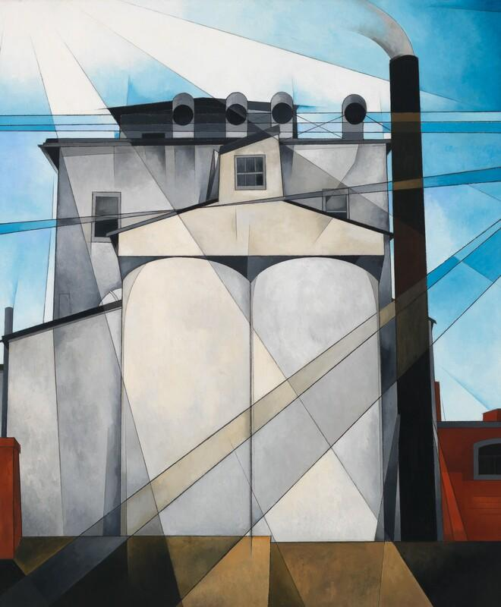
Charles Demuth | Art
My Egypt
Date: 1927
Medium:
Oil, fabricated chalk, & graphite pencil on composition board
Dimensions: roughly
30’’ x 36’’
In Demuth’s image, the majestic grain elevator rises up as the pinnacle of American achievement—a modern day equivalent to the monuments of ancient Egypt. A series of intersecting diagonal planes add geometric dynamism add a heavenly radiance to the composition, invoking the correlations between industry and religion that were widespread in the 1920s. Nonetheless, Demuth may have intended the title to allude to the slave labor that built the pyramids, intimating the dehumanizing effect of industry on the nation’s workers. Moreover, the pyramids and their association with life after death might also have appealed to the ailing artist, who was bedridden with diabetes at the time of the painting’s execution.

Slide 9
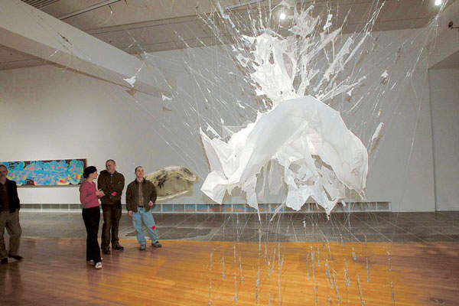
E.V. Day | Crafts
Bombshell
Date: 1999
Medium:
White crepe dress with monofilament and turnbuckles
Dimensions: roughly
16 ft x 20 ft (installation)
In each installation, a spectacular evening dress, cut into hundreds of pieces, is suspended in midair by an elaborate system of monofilament lines attached to the floor and ceiling with turnbuckles. The dresses appear to be frozen in the midst of a violent explosion. For Bombshell, Day created an 8-foot-high reproduction of the white halter dress immortalized by Marilyn Monroe in the movie, The Seven Year Itch (1955).

Slide 10
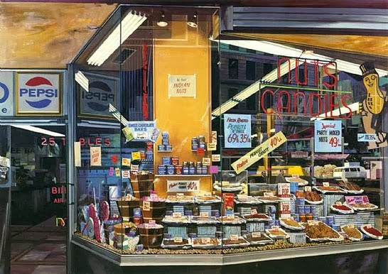
Richard Estes | Art
The Candy Store
Date: 1969
Medium:
Oil & Acrylic on Linen
Dimensions: roughly
48’’ x 68’’
In this painting, Richard Estes scrupulously represents not only the signs, displays, and sugared goods for sale at a New York City candy shop but, in smooth glass reflections, the world beyond the store—the facades of facing buildings and a white parked van. Both the reflections on the store windows and the inside of the store are equally visible and clear. For all of its visual accessibility, The Candy Store is a sophisticated meditation on the processes of sight and representation. It replicates the experience of seeing the store and peering into the window while walking down the street, capturing depth and recession in the depiction of several angled fluorescent lights while at the same time remaining emphatically flat and frontal.

Slide 11
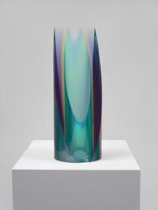
Fred Eversley | Crafts
Untitled
Date: 1970
Medium:
Resin
“Using plastic resin, he developed a formal sculptural language that reflected the West Coast style, a seemingly more decorative approach to minimalism that appeared to take its cues from the synthetic materials and mechanized surfaces of hot rods, surfboards and the aerospace industry. He was responsible for supervising the design and construction of high-intensity acoustic and vibration test laboratories at NASA facilities.”

Slide 12
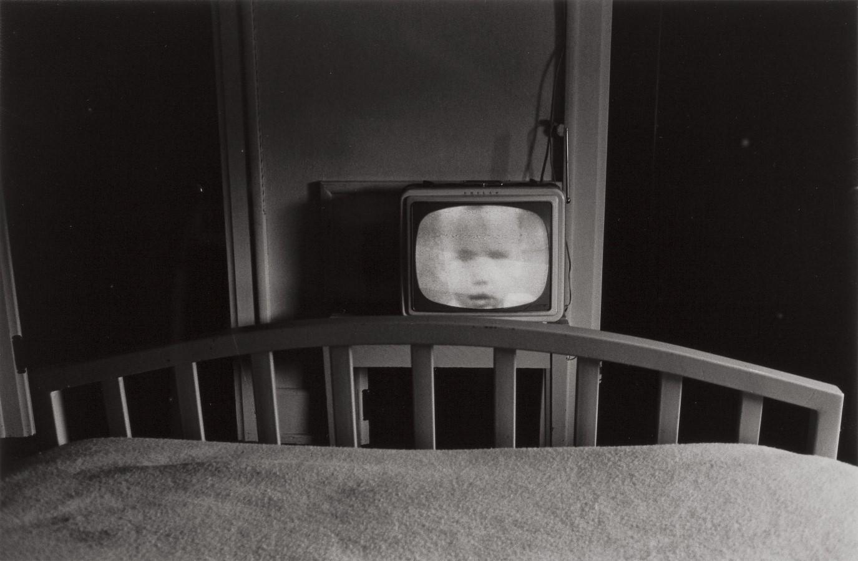
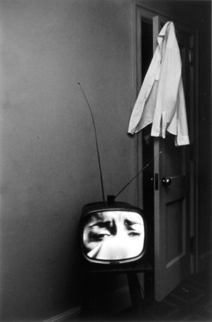
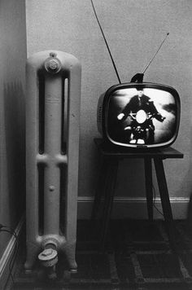
Lee Friedlander | Art
The Little Screens Series
Date: 1962
Medium:
Silver Gelatin Print
Extensively traveled, Friedlander has had more than his share of hotel rooms and temporary lodgings. In the early 1960s, characteristic of his methods, Friedlander’s eye recurrently landed on television screens (then a relatively recent luxury appliance) in these lonely rooms. The half-light broadcast from the luminous boxes cast an unearthly pall over the quotidian objects of everyday life.

Slide 13
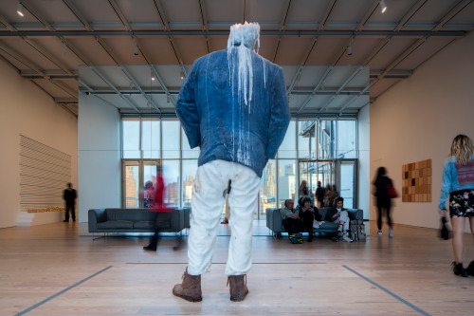
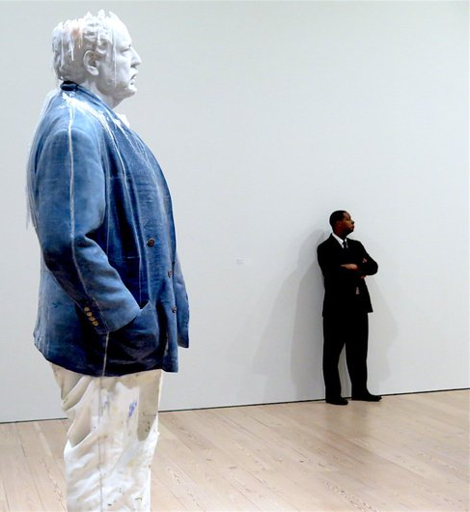
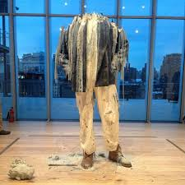
Urs Fischer | CRAFTS
Standing Julian
2015
Wax, pigment, steel, wicks
Standing Julian is a portrait of Urs Fischer’s friend and fellow artist Julian Schnabel. The massive sculpture is also a wax candle: lit every morning and extinguished each night, Standing Julian will slowly melt over the course of Human Interest: Portraits from the Whitney’s Collection. Although this candle will eventually burn down and be discarded, the sculpture can also be recast and lit anew. As Fischer explains, his waxworks allow “materials and images to take on their own life.”

Slide 14
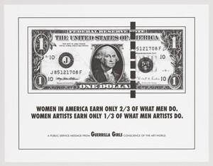
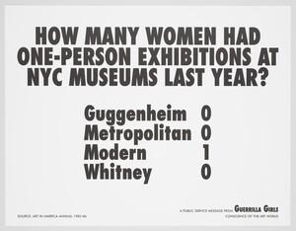
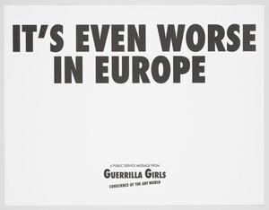
Guerrilla Girls | ART
Guerrilla Girls’ Portfolio
1985-2012
Women in American Earn Only 2/3 of What Men Do. Women Artists Earn Only 1/3 of What Men Do.
1985
Poster
Guerrilla Girls are an anonymous group female artists devoted to fighting sexism and racism within the art world. The group formed in New York City in 1985 with the mission of bringing gender and racial inequality in the fine arts into focus within the greater community. Members are known for the gorilla masks they wear to remain anonymous.
Guerrilla Girls were formed by seven women artists in the spring of 1985 in response to the Museum of Modern Art's exhibition "An International Survey of Recent Painting and Sculpture," which opened in 1984. The exhibition was the inaugural show in the MoMA's newly renovated and expanded building, and was planned to be a survey of the most important contemporary art and artists in the world.
In total, the show featured works by 169 artists, of whom only 13 were female.

Slide 15
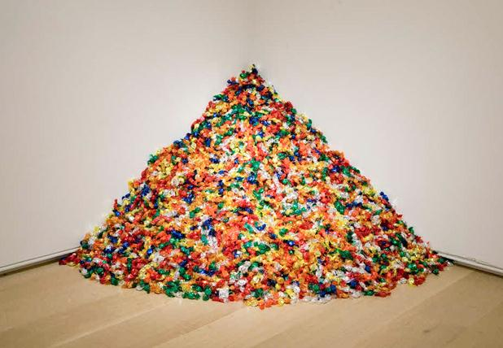
Felix Gonzalez-Torres | CRAFTS
A Portrait of Ross
**19 candy installations (most untitled)**
Individually Wrapped Candy
1991
Gonzalez-Torres was considered within his time to be a process artist due to the nature of his 'removable' installations by which the process is a key feature to the installation. Many of his installations invite the viewer to take a piece of the work with them: a series of works allow viewers to take packaged candies from a pile in the corner of an exhibition space and, in so doing, contribute to the slow disappearance of the sculpture over the course of the exhibition.
One interpretation of his work was seen a metaphor for death. Gonzlaez-Torres and his partner both had AIDS and died before they were 40.
Clocks, lightbulbs, or candy all disappearing or being replaced…

Slide 16
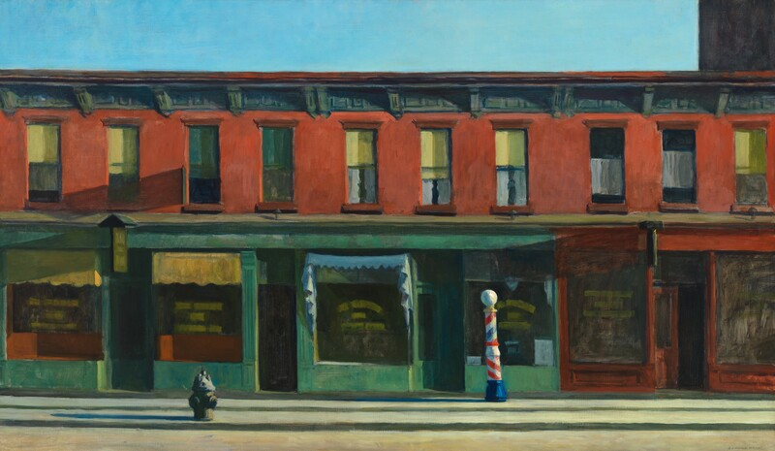
Edward Hopper | ART
Early Sunday Morning
1930
Oil on Canvas
Early Sunday Morning is one of Edward Hopper’s most iconic paintings. Although he described this work as "almost a literal translation of Seventh Avenue," Hopper reduced the New York City street to bare essentials. The lettering in the window signs is illegible, architectural ornament is loosely sketched, and human presence is merely suggested by the various curtains differentiating discrete apartments.

Slide 17
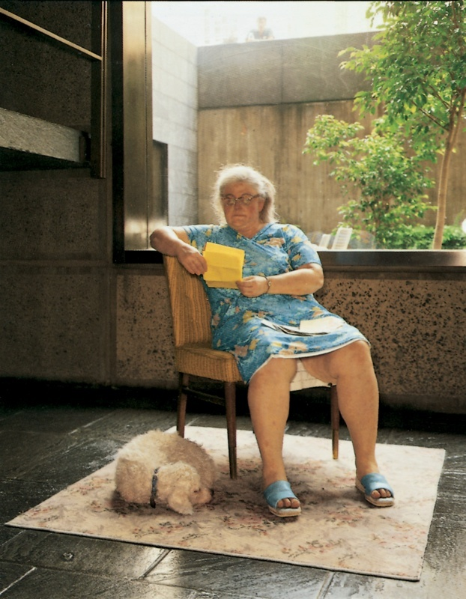
Duane Hanson | CRAFTS
Woman with Dog
Acrylic and oil on cast polyvinyl
….. with clothing, hair, eyeglasses, watch, shoes, upholstered wood chair, dog hair, leather collar, woven rug, postcard, letters, and envelopes
1977
Hanson often worked on a single figure for up to one year—locating models, making polyvinyl casts directly from their bodies (a method he developed in 1967), assembling and painting the casts, and finally outfitting the sculptures with clothing and accessories. Despite their extreme realism, however, Hanson’s sculptures are not usually likenesses of specific people. The pile of letters in Woman with Dog, for example, is addressed to a Minnie Johnson, but the model for the work was someone else who lived near Hanson’s Florida studio. Woman with Dog thus presents a constructed, even composite character. As Hanson remarked, "I wanted a credible, unpretentious working class type of woman at mail time enjoying the fellowship of a friendly letter and her pet dog."

