Slide 1
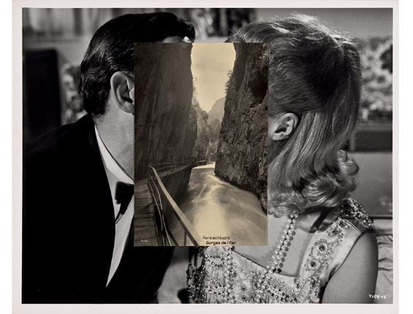
Restore and Montage
*learn to digitally restore so you can salvage all your moms old photos ! ! !

Slide 2
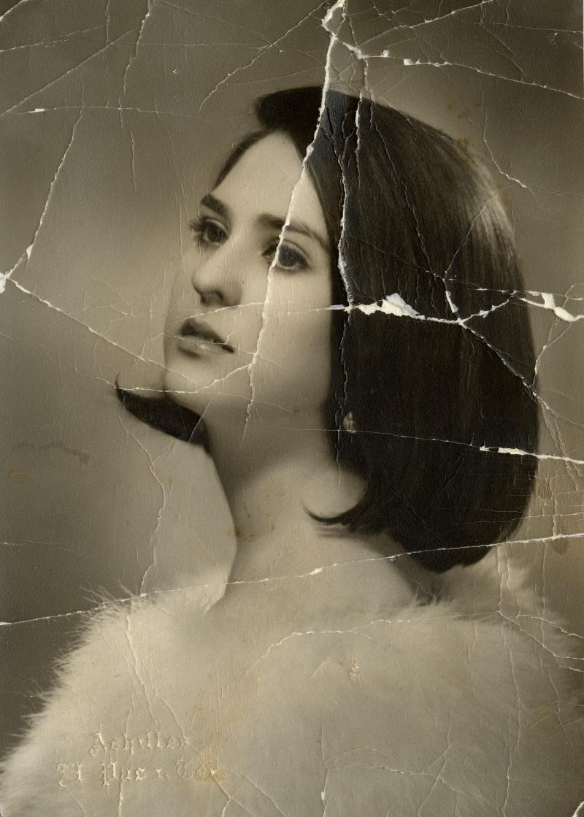
We will be utilizing our restoring tools on photoshop:
Clone Stamp Tool
Patch Tool
Spot Healing Brush
For today you will be working with the images you archived in your google drive folder.
Pull 1 image at a time to work on in photoshop
For each image you should duplicate the background layer. NEVER MAKE ADJUSTMENTS ON THE ORIGINAL FILE!!!
Rename duplicate layer “name_background”
Add blank layers when you begin to use a new tool.
One layer per tool! Name nach layer based on tool: ex/ “patchtool_1”

Slide 3
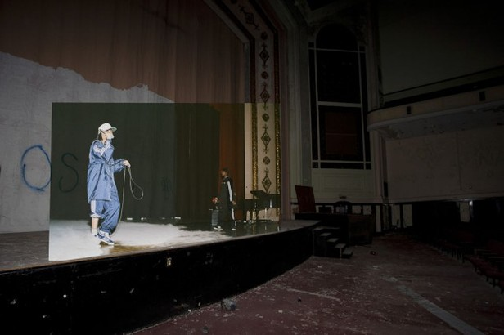
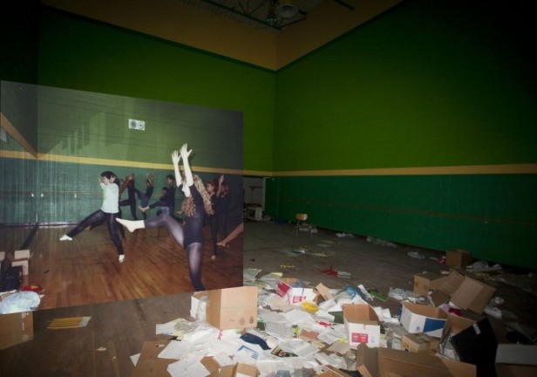
One old, One new
How can you marry two images together? How can you conjoin two images that are visually juxtaposed into perfect harmony?

Slide 4
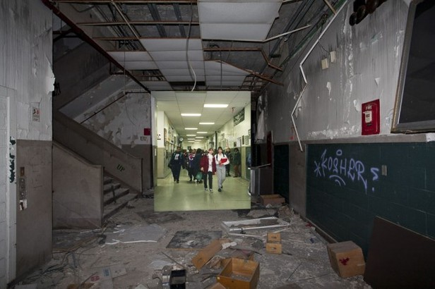

Slide 5
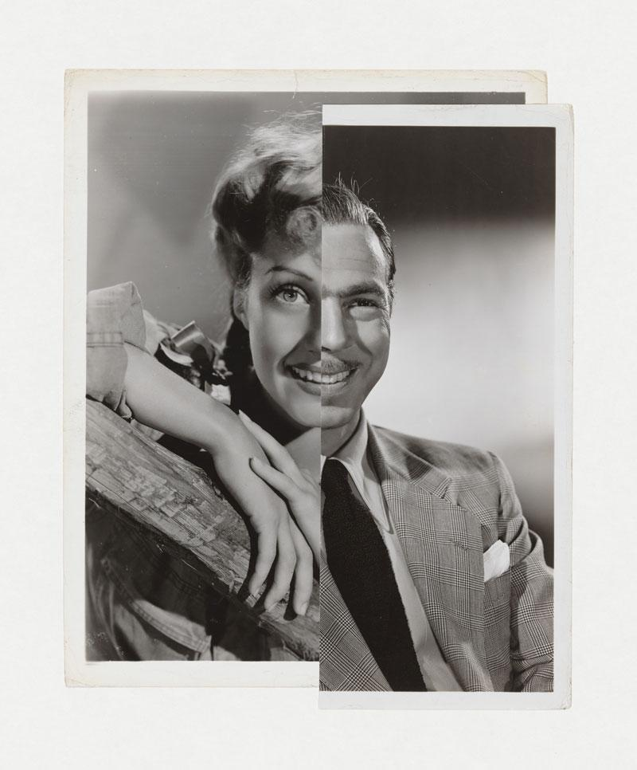
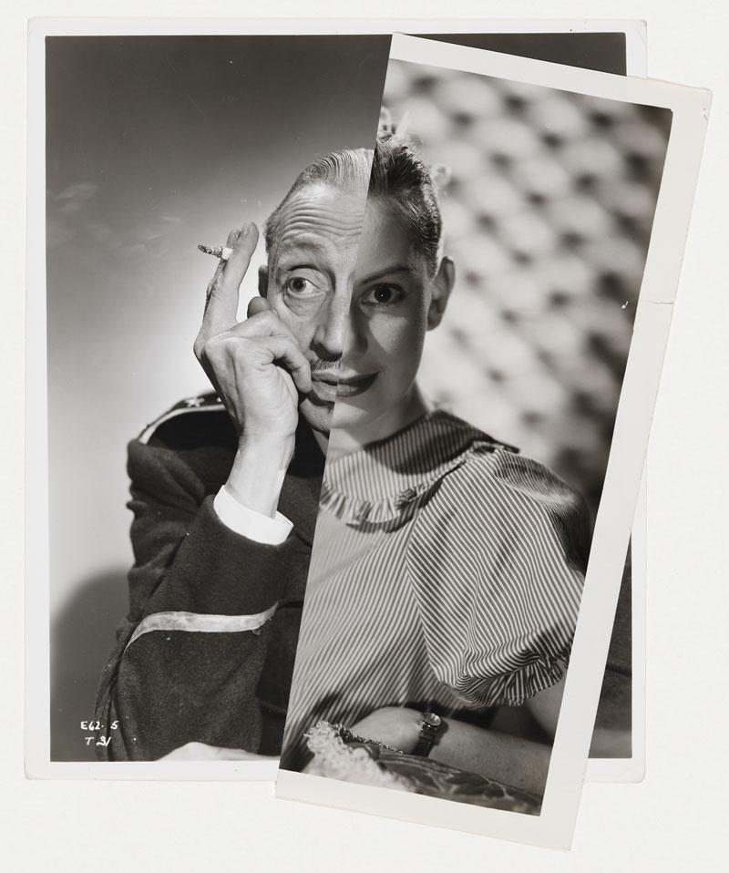
J
O
H
N
S
T
E
Z
A
K
E
R

Slide 6
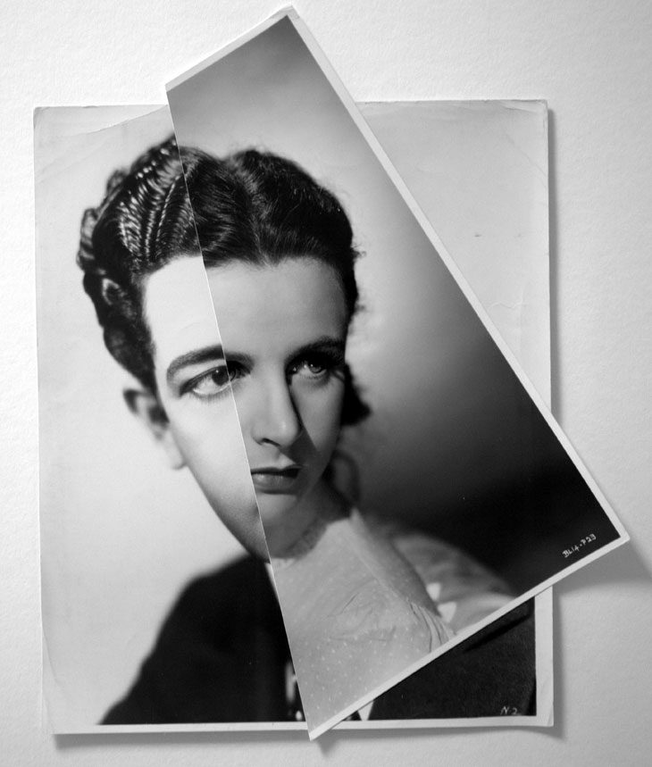
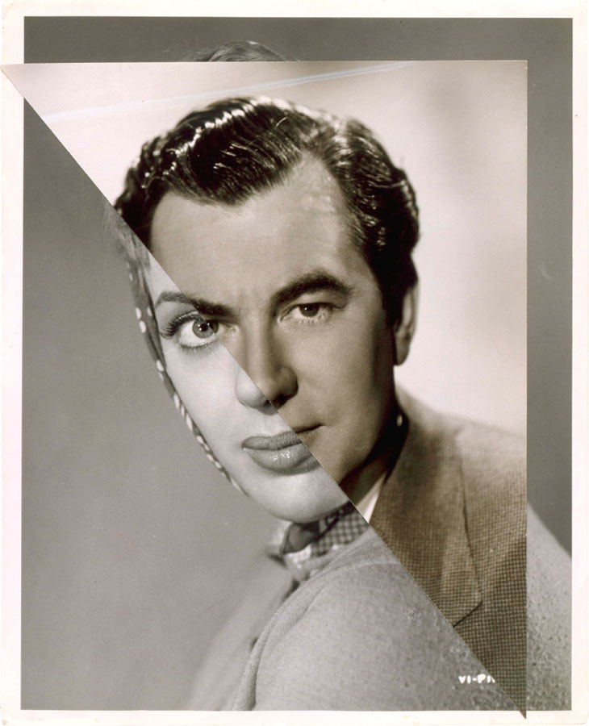
John Stezaker’s work re-examines the various relationships to the photographic image: as documentation of truth, purveyor of memory, and symbol of modern culture. In his collages, Stezaker appropriates images found in books, magazines, and postcards and uses them as ‘readymades’. Through his elegant juxtapositions, Stezaker adopts the content and contexts of the original images to convey his own witty and poignant meanings.

Slide 7
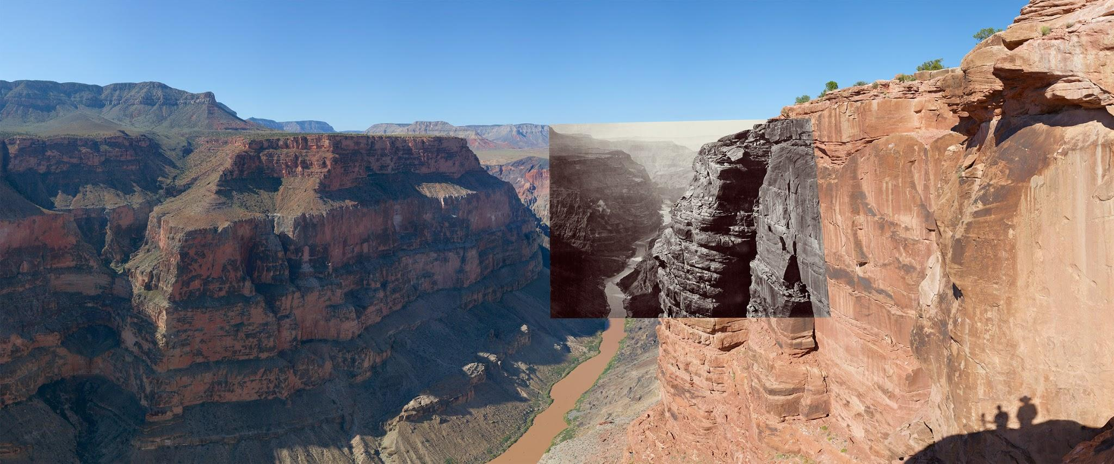
Mark Klett & Bryon Wolf

Slide 8
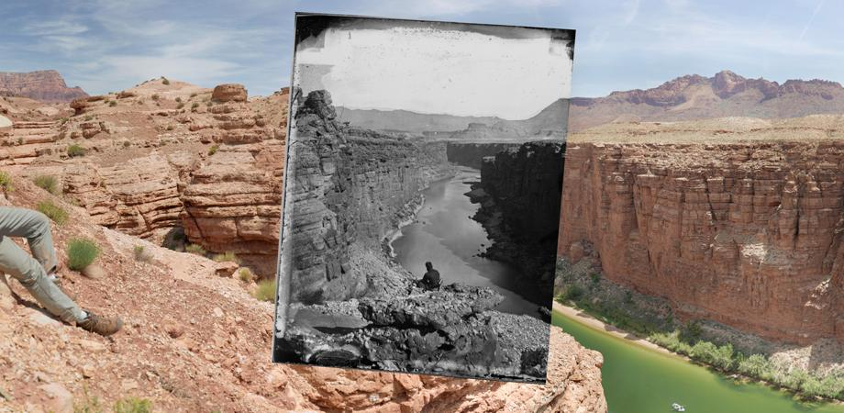
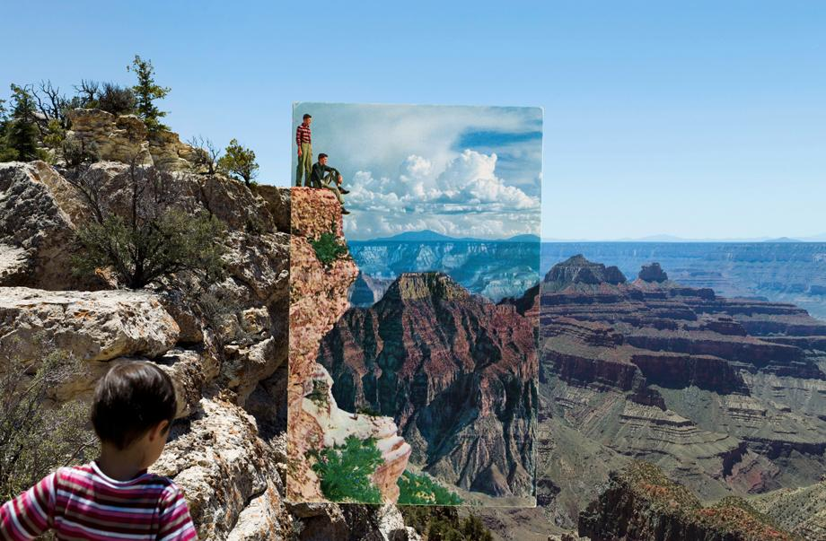

Slide 9
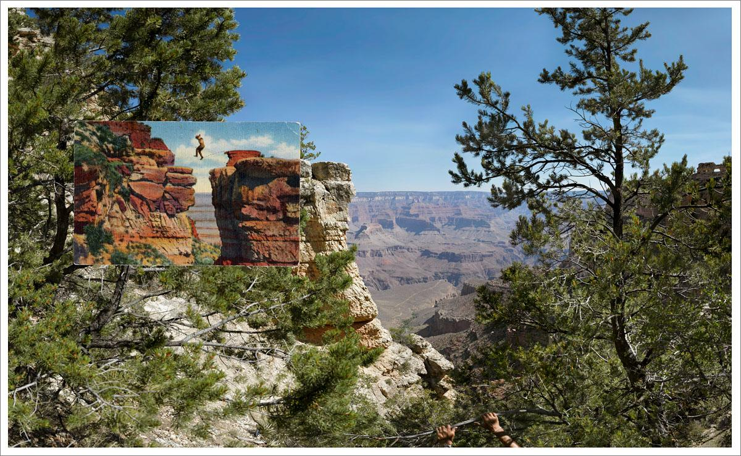
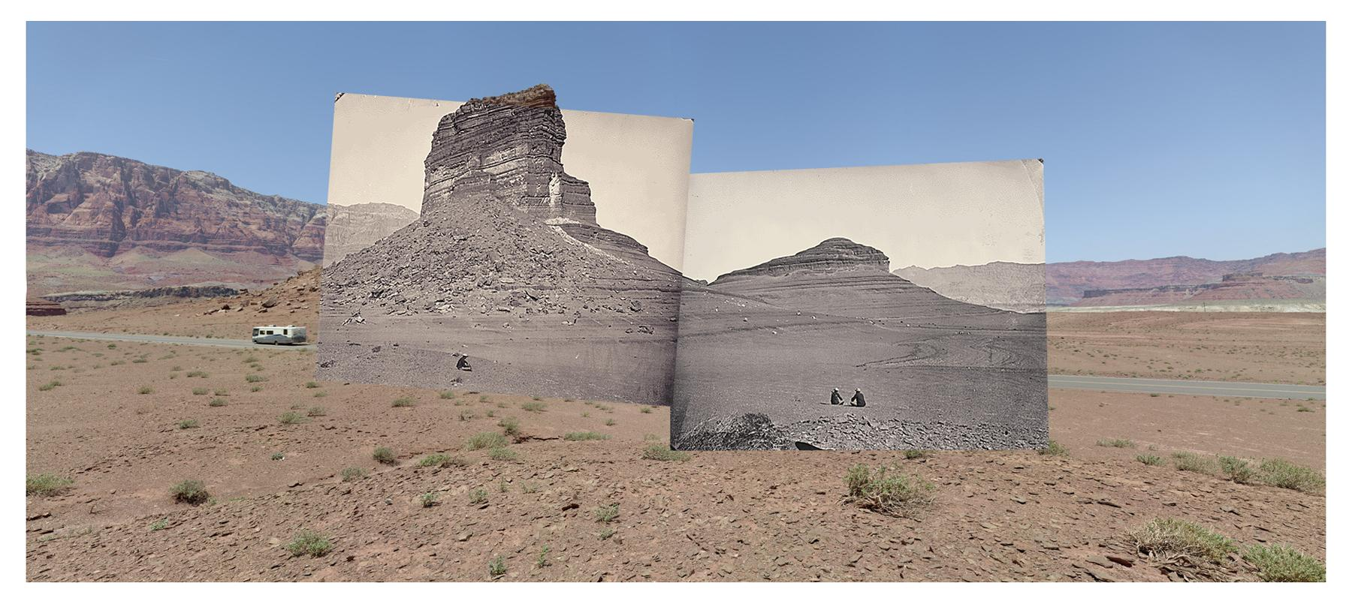
Collect photos from home/online that have obvious deterioration to use for your final project.
Could be photos from any time but make sure there is at least one subject matter to montage with.
IF you are extracting online photos make sure you are getting the highest quality resolution!
We will be focusing on portraiture.
You will restore one image and shoot new images to montage over.

